Slide 1
Introduction to Information and Communication Technologies
Lesson 6. What is the Internet?
Notes:
To the trainer:
This lesson should enable the trainees to use the Internet with competence and to teach others how to use it. Lead them to useful sites.
There are no further notes for the trainer.

Slide 2
Scope
What is the Internet ?
What Internet tools are available?
What is the World Wide Web?
What is e-mail? FTP? Chat?
What are online information resources?
Why is the Internet important to libraries?
What are some issues and concerns in using the Internet?

Slide 3
Learning outcomes
By the end of this lesson, you should be able to:
Define what is the Internet and other Internet concepts and terms.
Describe Internet tools and services.
Identify information resources for libraries on the Internet.
Use online information resources on the Internet.
Realize the importance of Internet to libraries.
Discuss some issues and concerns regarding the use of Internet in libraries.

Slide 4
What is the Internet?
The Internet is a global network of computers communicating under one set of guidelines, formally called Transmission Control Protocol/Internet Protocol (TCP/IP).

Slide 5
The Internet
The Internet is more than a physical network of wires linking individual computers to one another.
It is also a network of people
and information resources.

Slide 6
The Internet is not a specific place, company, or service, although places, companies and services are accessible via the Internet. Nobody owns the Internet.

Slide 7
How do you connect to the Internet?
Basically you will need:
a personal computer
a modem and a telephone line
an Internet Service Provider (provides the software, the IP address, and the link to the Internet)
a network card if connecting to home or office network

Slide 8
What can you do on the Internet?
World Wide Web
Electronic Mail
FTP
Talk/Chat
Online information resources
Others

Slide 9
The World Wide Web
The World Wide Web is the collective name for all the computer files in the world that are :
accessible through the Internet located on and provided by a large number of Web servers
electronically linked together, made possible by HyperText Transfer Protocol (HTTP) and HyperText Markup Language (HTML),;
viewed, experienced or retrieved through a “browser” program running on your computer

Slide 10
The Web components
Web browsers and servers - Web browsers are application software used to access files or applications which are located and run by Web servers.
Web contents - files in several formats text, multimedia, video, audio, etc...that are available through the World Wide Web
HTTP and HTML - HTTP is the protocol used in World Wide Web to transfer files from one computer to another while HTML is used to format and display Web pages containing

Slide 11
Web browsers and servers
4. Server sends requested
files to browser to be
interpreted.
5. User receives file
Browser
1. User sends request
3. Server accepts
and processes
request from
browser.
2. Browser interprets user’s
selection and makes request from
appropriate server.

Slide 12
Examples of browsers
Netscape Navigator
Microsoft Internet Explorer
Opera
Neoplanet
Lynx
More…

Slide 13
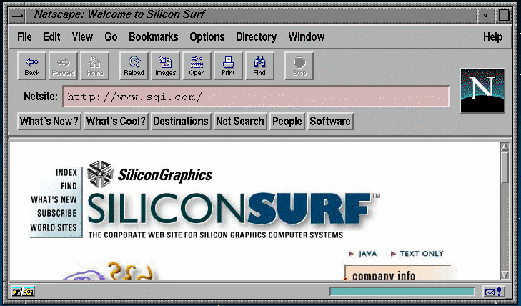
Netscape Navigator

Slide 14
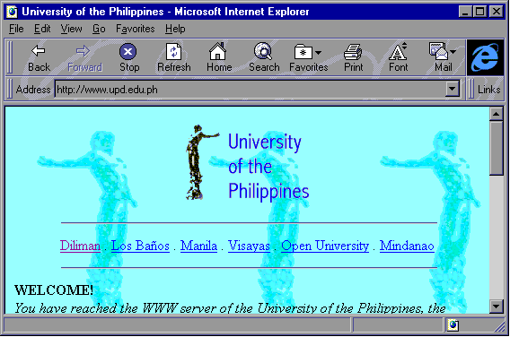
Microsoft Internet Explorer

Slide 15
Web Content
Text
Sound
Images
Video
Animation
Full-text
Statistical data
Abstracts/Indexes
Software
Library catalogs
News
And more

Slide 16
HTTP and HTML
Web servers and browsers use HyperText Transfer Protocol (HTTP), an Internet-standard protocol, to handle the transfer of text and other files between different computers.
HTTP “defines how messages are formatted and transmitted, and what actions Web servers and browsers should take in response to various commands.”
HTML defines how Web pages are formatted and displayed by web browsers

Slide 17
Hyperlinks between Web resources
Hyperlinks are special HTML codes included in Web pages that connect Web resources, instruct the browser to fetch a resource, run an application or jump to another site.
Hyperlinks consist of the following:
HTML tags - instruct Web browser and Web servers what file to get or what program to run, includes URL’s and/or pointers to applications and files to run
Anchor – text or image used to place a hyperlink, the clickable object that activates the hyperlink
Uniform Resource Locators (URL) – address of the Web resources

Slide 18
Sample URL’s
http://lcweb.loc.gov
http://www.ifla.org
http://www.ala.org
http://library.albany.edu/internet/
http://www.internet101.org/
http://whatis.techtarget.com/
http://webopedia.internet.com/

Slide 19
Electronic Mail (e-mail)
Uses:
exchange correspondence
transfer documents
subscribe to news services
get computer software
Format: username@hostname.domain
example: me@hotmail.com

Slide 20
Transferring files from one computer to another
The File Transfer Protocol (ftp) allows you to copy a file from a remote computer to your desktop and vice versa
Syntax:
ftp <ftp.sunsite.edu>
Logging in
username
password

Slide 21
Real-time communication using the Internet
Talk / ytalk
talk <user address>
IRC - Internet Relay Chat
irc <nickname> <irc server>
Freetel, iPhone, etc.

Slide 22
What are online information resources?
Locally available databases: library catalogs, abstracts and indexes, full-text, multimedia
Directly available from hosts: abstracts and indexes, full-text, multimedia
Available via the Internet:abstracts, indexes, e-journals and other full text documents, multimedia
Notes:
To the trainer:
Compare and contrast the different services.

Slide 23
Online information resources
Multimedia
Abstracts and
Indexes
Music
Sound
Full-text
documents
Video

Slide 24
Internet accessible library catalogs and databases
Many libraries have published their library catalogs on the Internet.
Databases (abstracts and indexes) are accessible online via the Net. Some charge fees but some are free.

Slide 25
Online databases / references
Library of Congress Catalog
OCLCs First Search.
Commercial services: EBSCO, ISI H.W. Wilson, OVID
Encyclopedias, dictionaries, directories, newspapers
Other
Notes:
To the trainer:
Use the Internet to search the Library of Congress site, OVID, newspapers, etc.

Slide 26
Why is the Internet important to librarians?
1. Many information resources may be accessed through the Internet:
online library catalogs
documents in various formats
databases
educational and information services
2. Documents can be sent through the Internet (e.g, e-mail, FTP, file-sharing)
3. Librarians can communicate with people using e-mail, chat, newsgroups etc…

Slide 27
Issues
Copyright
Privacy
Security
Netiquette
Censorship
Quality
Quantity
Archiving

